Slide 1

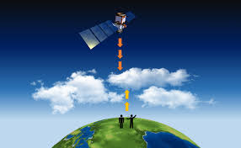
Below Cloud Aerosol Interaction
Names …
Improve data gathering under the clouds
ATLID sensor data, other JAXA products for validation
Data analysis
Cloud fractions on aerosol concentrates

